Slide 1
The Foundations of Open Science
Sinéad Hanrahan - Digital Scholarship Services Librarian - OER24 28th March 2024

Slide 2
Who I Am
Librarian
I work primarily within Research
Open Science
Research Integrity
Virtue Ethics
Notes:
In that time I have trained hundreds of people, nationally and internationally, in these areas. And in that time, my major take-away is that researchers are not as grounded in the basics of research practices as I had assumed. I have spoken to my library colleagues around the country on this, and they report on a similar experience.

Slide 3
Challenges
Low take up
Minimal understanding
Unsatisfactory research methodological understanding
Coincide with increases in Research Misconduct
Increased pressures to publish
Limited resourcing
Notes:
In that time I have trained hundreds of people, nationally and internationally, in these areas. And in that time, my major take-away is that researchers are not as grounded in the basics of research practices as I had assumed. I have spoken to my library colleagues around the country on this, and they report on a similar experience.
The RI course, could see that dedicated time did see improvements in student understanding and research practice.

Slide 4
Providing the Answer to a Question Researcher’s Hadn’t Asked
Data
Open Data
Notes:
All of this stewing in my head led me to this realization: I was providing an answer to a question the researchers I was training hadn’t asked. Maybe didn’t even know to ask.
What this came down to was understanding that the training I was providing was answering a question that most researchers had never asked. This meant that before I speak about Open Data, I need to lay the foundation be teaching about data. Similarly, if I want people to understand why Open Access is important for research integrity, I have to start with establishing the problems within scholarly communications.

Slide 5
What I Did
SATLE Funding
Application
RICO Collaborations
OERs
TEL
Notes:
Working closely with the RICO and had agreed to develop a digital badge in the basics of Open Science. I had experience of developing OERs and felt they were a good fit for what I wanted to achieve. I secured SATLE funding, confirmed in June, work started in Late September/October.

Slide 6
The Topics
Open Science
Research 🡪 Open
Research
Resource
Copyright & Licensing
Open Data
Open Access
Notes:
I felt that if people could understand that at the heart of Open Science and RI is the friction between who creates something, who owns it, who licenses it, who gets paid and who gets credit, they would have the best chance of understanding why engaging in Open Science is important for research.

Slide 7
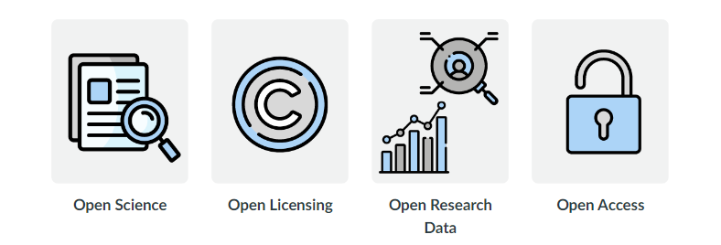
The Topics
Research 🡪 Open
Research
Resource
Introduction to Research Practices
Copyright
Research Data
Scholarly Publishing
Open Science
Open Licensing
Open Data
Open Access
Notes:
From that there it was just a matter of connecting the open practices to its origin topic. The information from each module was threaded through the next, building on knowledge step by step.

Slide 8
Module Design
Clearly outlined Learning Outcomes
Short and snappy information
Authoritative sources
Various media types
Reuse of open material
Knowledge checks
Interactive components
Research 🡪 Open
Research
Resource
Notes:
From that there it was just a matter of connecting the open practices to its origin topic. The information from each module was threaded through the next, building on knowledge step by step.

Slide 9
The Foundations of Open Science

Slide 10
Module 1 – Learning Outcomes
Resarch 🡪 Open
Open Science
Research
Resource
Define Research
Outline the research process
Describe what Open Science is
Understand why Open Science is important for research integrity
Notes:
From that there it was just a matter of connecting the open practices to its origin topic. The information from each module was threaded through the next, building on knowledge step by step.

Slide 11
Module 2 – Learning Outcomes
Resarch 🡪 Open
Open Licensing
Research
Resource
Describe copyright
Understand licensing of copyrighted material
Recognise Creative Commons licenses
Notes:
From that there it was just a matter of connecting the open practices to its origin topic. The information from each module was threaded through the next, building on knowledge step by step.

Slide 12
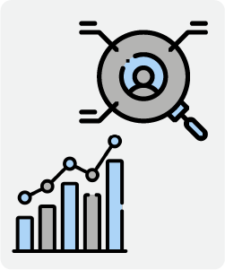
Module 3 – Learning Outcomes
Resarch 🡪 Open
Open Research Data
Research
Resource
Describe research data
Understand the difference between quantitative & qualitative data
Describe Open Research Data
Understand the Fair Principles
Notes:
From that there it was just a matter of connecting the open practices to its origin topic. The information from each module was threaded through the next, building on knowledge step by step.

Slide 13
Module 4 – Learning Outcomes
Resarch 🡪 Open
Open Access
Research
Resource
Understand the purpose and characteristics of peer-reviewed articles
List the stages of the research publishing cycle
Define Open Access
Identify different types of Open Access
Notes:
From that there it was just a matter of connecting the open practices to its origin topic. The information from each module was threaded through the next, building on knowledge step by step.

Slide 14
Digital Badge
Completion of all 4 modules
Score 80% or more
Display on Badger

Slide 15
What’s Next? - Building Competence
Foundation
Action Knowledge
Informed Planning
Foundational Knowledge
Basic concepts
Developing familiarity
Focus on most commonly known areas of Open
Open Science
Put into practice
Open Research Data
Open Access
Open Peer-review
Open Source
Design for Open
Design research with Open methodologies
Project plans
Ethics
Funder grants

Slide 16
Takeaways
Timelines far too short
Required bigger team
More testing
Clarity on role and offering of Ed Tech

Slide 17
Contact
Sinead.Hanrahan@mtu.ie
Sinéad Hanrahan
Digital Scholarship Librairan
Munster Technological University
ORCID: 0000-0003-2445-5854
+353 (021) 4326243

